Slide 1
Convolutional Neural Network and Applications
Presented By: Mohamed Ahmed

Slide 2
Index
Why We need Convolutional Neural Network?
What is the CNN made of?
What is Convolutional ?
Conv And invert Cross Correlation
Conv And invert Cross Correlation Mathematic Formula
Digital store
What is convolutional kernel?
Discrete Convolution Operations
Valid and Same Convolution
Stride Convolution

Slide 3
Index
The transition to the third dimension
Convolution Layers
Connections Cutting and Parameters Sharing
Convolutional Layer Backpropagation
Forward & Backward CNN
Finding the local gradient
Using the Chain Rule
∂L/∂X Representation
Pooling Layer
Pooling Backpropagation

Slide 4
Index
Training CNN
CNN in Real World App
Tesla Hydranet
RegNet (Body)
Feature pyramid networks (Neck)
Yolo (Head)

Slide 5
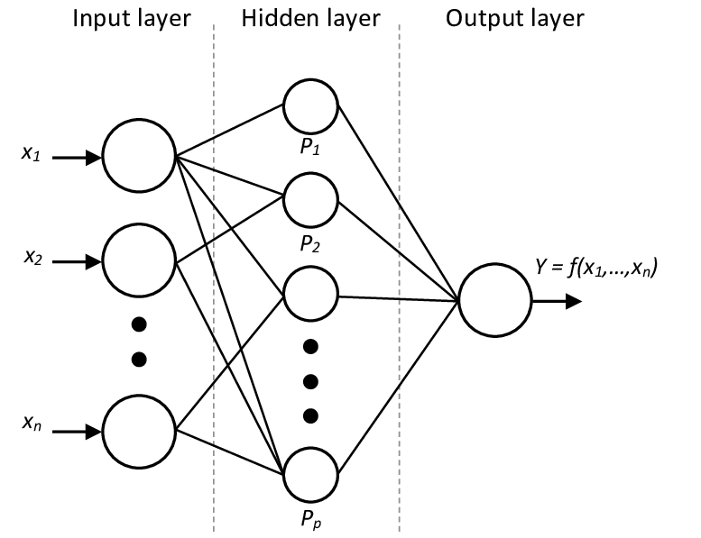
Why we need Convolutional Neural Network?
The traditional Densely connected neural networks, these are networks whose neurons are divided into groups forming successive layers. Each such unit is connected to every single neuron from the neighboring layers.
This approach works well when we solve classification problem based on a limited set of defined features
Notes:
ConvNets, were first introduced in the 1980s by Yann LeCun, a postdoctoral computer science researcher.
LeCun had built on the work done by Kunihiko Fukushima, a Japanese scientist who, a few years earlier, had invented the neocognitron, a very basic image recognition neural network.

Slide 6
Why we need Convolutional Neural Network?
the situation becomes more complicated when working with photos.
We could treat the brightness of each pixel as a separate feature and pass it on as an input to our dense network, unfortunately, in order to make it work for a now days photos, our network would have to contain tens or even hundreds of millions of neurons.
On the other hand, we could scale our photo down, but we would lose valuable information in the process.
we see that a traditional strategy does nothing for us we need a new clever way to use as much data as possible, but at the same time reduce the number of necessary calculations and parameters. That’s when CNNs comes into play.
Notes:
Main problem with fully connected layer:
When it comes to classifying images — lets say with size 64x64x3 — fully connected layers need 12288 weights in the first hidden layer! The number of weights will be even bigger for images with size 225x225x3 = 151875. Networks having large number of parameter face several problems, for e.g. slower training time, chances of overfitting
The main functional difference of convolution neural network is that, the main image matrix is reduced to a matrix of lower dimension in the first layer itself through an operation called Convolution. For e.g. an image of 64x64x3 can be reduced to 1x1x10. Following which subsequent operations are performed.
Ref: https://medium.datadriveninvestor.com/convolution-neural-networks-vs-fully-connected-neural-networks-8171a6e86f15

Slide 7
What is the CNN made of?
So what is Convolutional neural network acutely made of, we need to understand 3 parts
What is Convolutional?
How to apply Convolutional on image?
How Conv layer work?

Slide 8
What is Convolutional ?
Convolution is a mathematical operation on two functions (f and g) that produces a third function ( f ∗ g) that expresses how the shape of one is modified by the other.
The term convolution refers to both the result function and to the process of computing it, It is defined as the integral of the product of the two functions after one is reversed and shifted.
Some features of convolution are similar to cross-correlation:
For real-valued functions, of a continuous or discrete variable,
It differs from cross-correlation ( f ⋆ g ) only in that either f(x) or g(x) is reflected about the y-axis; thus it is a cross-correlation of g(-x) and f(x), or f(−x) and g(x).
Notes:
For complex-valued functions, the cross-correlation operator is the adjoint of the convolution operator.
Adjoint:- In mathematics, specifically in operator theory, each linear operator A on a Euclidean vector space defines a Hermitian adjoint (or adjoint) operator A* on that space according to the rule
<Ax, y> = <x, A*y>
, is dot product
######################################################################################
Integeral Explination
https://www.youtube.com/watch?v=PbYe01FmDW8
Simply, correlation is a measure of similarity between two signals, and convolution is a measure of effect of one signal on the other.

Slide 9
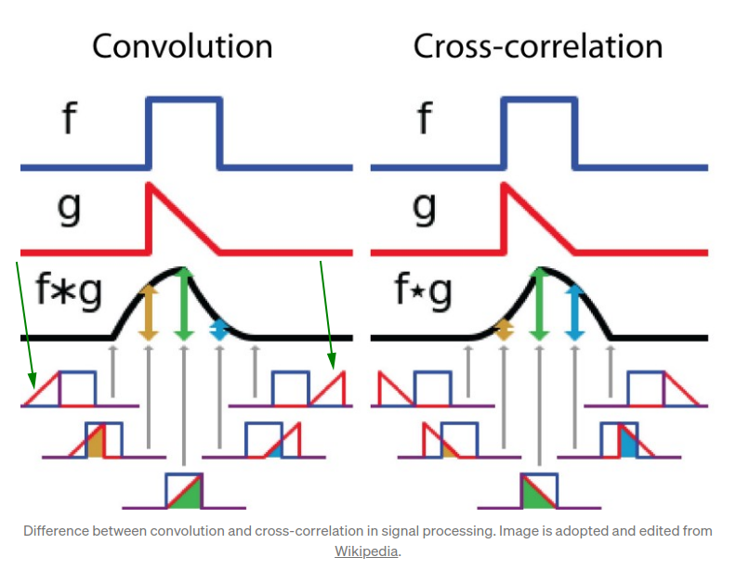
Conv And invert Cross Correlation
So as we say It differs from cross-correlation ( f ⋆ g ) only in that either f(x) or g(x) is reflected about the y-axis; thus it is a cross-correlation of g(-x) and f(x), or f(−x) and g(x).
Notes:
Conv vs Cross-Corr: https://www.youtube.com/watch?v=C3EEy8adxvc

Slide 10
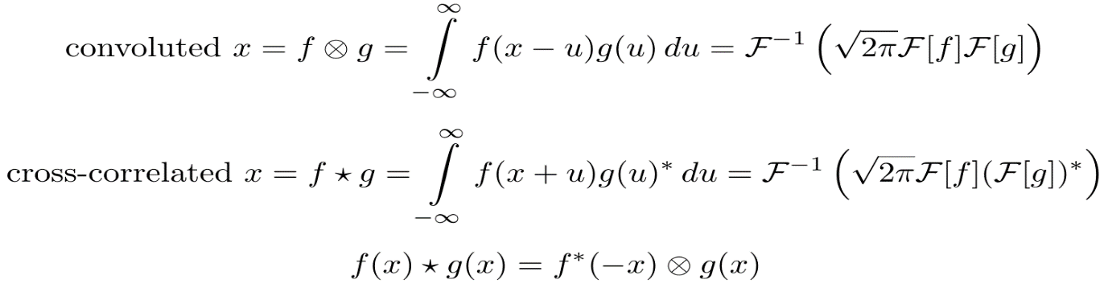
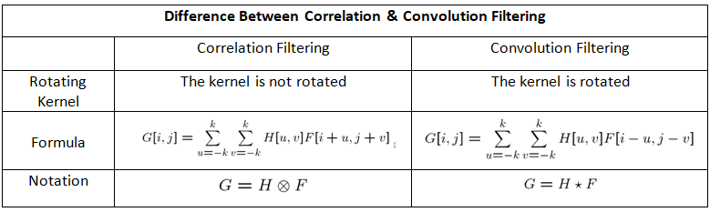
Conv And invert Cross Correlation Mathematic Formula
For continues variables
For discrete variables
Notes:
How to integral Conv: https://www.youtube.com/watch?v=PbYe01FmDW8
Discrete: https://medium.com/@aybukeyalcinerr/correlation-vs-convolution-filtering-2711d8bb3666
Continues: Hands-On Image Processing with Python by Sandipan Dey

Slide 11
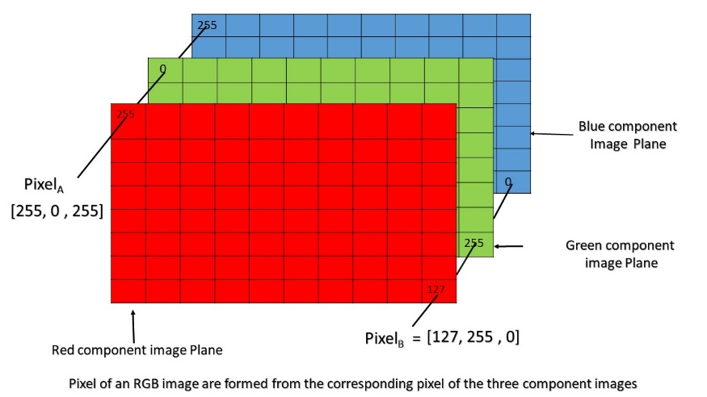
Digital store
Most of images consist of a huge matrices of numbers. Each such number corresponds to the brightness of a single pixel In RGB shape,
the color image is actually composed of three such matrices corresponding to three color channels (red, green and blue).
In black-and-white images we only need one matrix.
Each of these matrices stores values from 0 to 255 (1 Byte).

Slide 12
What is convolutional kernel?
In Convolutional neural network, the kernel is or a filter that is used to extract the features from the images. The kernel is a matrix that moves over the input data, performs the dot product with the sub-region of input data, and gets the output as the matrix of dot products.
It could be
Sobel filter for edges and lines
Laplacian: edges detector
Canny: Edge detection
Color detection filter
Notes:
Laplacian: an edge detector used to compute the second derivatives of an image, measuring the rate at which the first derivatives change.
Canny: uses linear filtering with a Gaussian kernel to smooth noise and then computes the edge strength and direction for each pixel in the smoothed image.

Slide 13
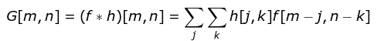
Discrete Convolution Operation
It is a process where we take a small matrix of numbers (called kernel or filter), we pass it over our image and transform it based on the values from filter. Subsequent feature map values are calculated according to the following formula, where the input image is denoted by f and our kernel by h, the indexes of rows and columns of the result matrix are marked with m and n respectively.

Slide 14
Discrete Convolution Operation
After placing our filter over a selected pixel, we take each value from kernel and multiply them in pairs with corresponding values from the image. Finally we sum up everything and put the result in the right place in the output feature map (DOT product). we will see how such an operation looks like in micro scale, but what is even more interesting, is what we can achieve by performing it on a full image.
Notes:
Dot Product: https://towardsdatascience.com/linear-algebra-basics-dot-product-and-matrix-multiplication-2a7624942810

Slide 15
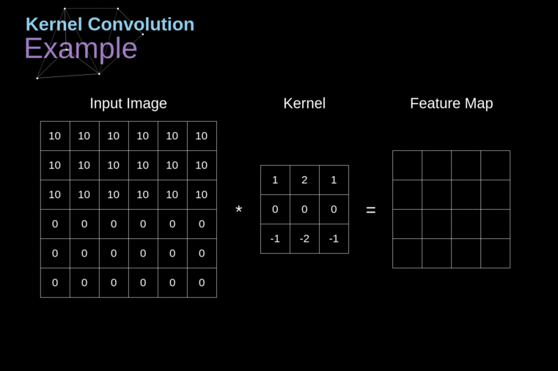
Discrete Convolution Operation

Slide 16
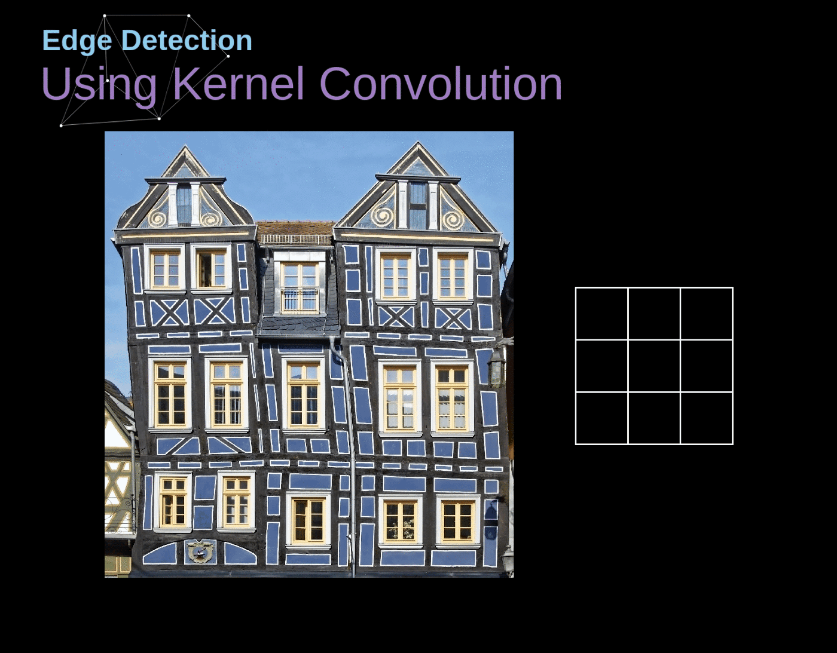
Discrete Convolution Operation

Slide 17
Valid and Same Convolution
Since our image shrinks every time we perform convolution, we can do it only a limited number of times, before our image disappears completely.
if we look at how our kernel moves through the image we see that the impact of the pixels located on the outskirts is much smaller than those in the center of image.
This way we lose some of the information contained in the picture.

Slide 18
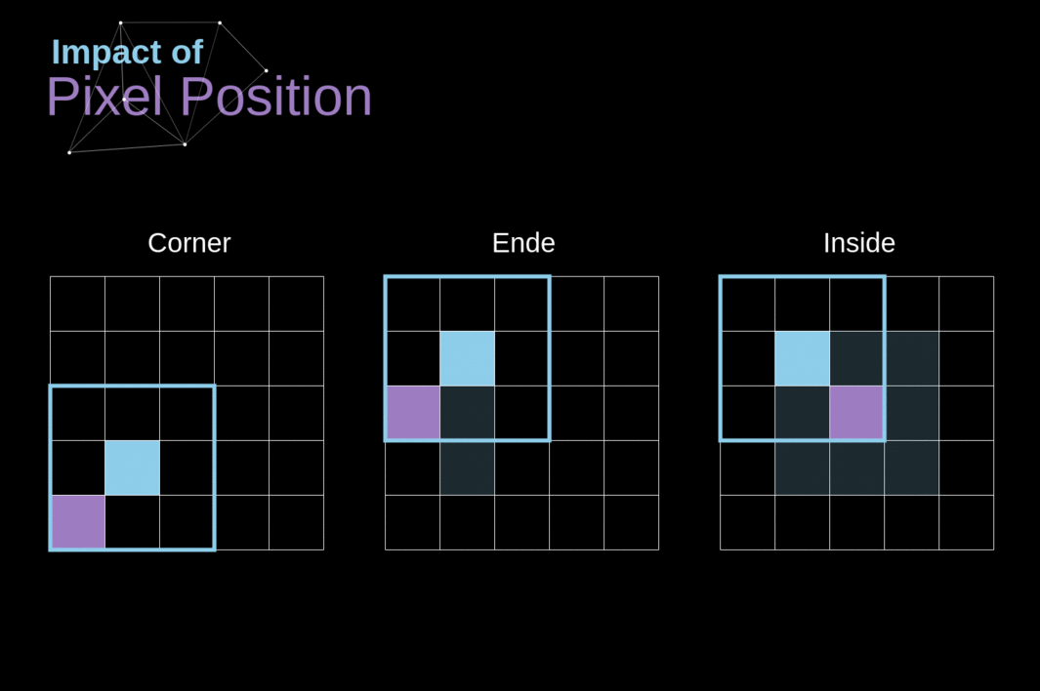
Valid and Same Convolution
the position of the pixel changes its influence on the feature map

Slide 19
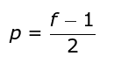
Valid and Same Convolution
To solve both of these problems we can pad our image with an additional border.
For example,
if we use 1px padding, we increase the size of our photo to 8x8, so that output of the convolution with the 3x3 filter will be 6x6. Usually in practice we fill in additional padding with zeroes.
Depending on whether we use padding or not, we are dealing with two types of convolution Valid or Same.
Valid: means that we use the original image.
Same: we use the border around it
So that the images at the input and output are the same size. In the second case, the padding width, should meet the following equation, where p is padding and f is the filter dimension (usually odd).

Slide 20
Stride Convolution
We always shifted our kernel by one pixel, However, step length can also be treated as one of convolution layer hyper parameters.
When designing our CNN architecture, we can decide to increase the step if we want the receptive fields to overlap less or if we want smaller spatial dimensions of our next map.

Slide 21
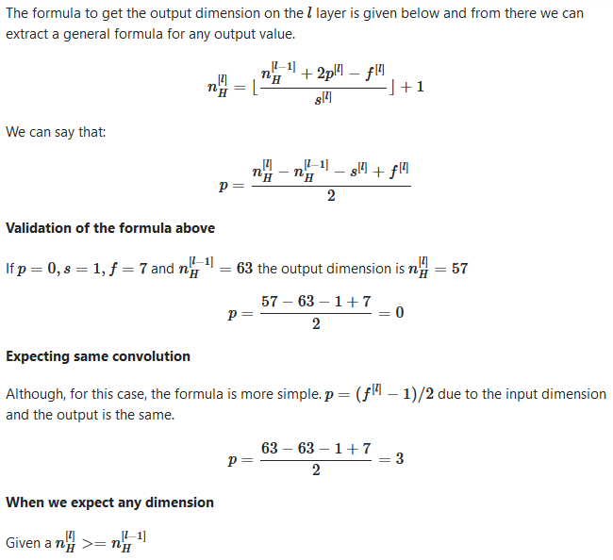
Stride Convolution
Notes:
Where n^(l-1) is the input (from previous layer)
And n(l) is the output (for current layer)

Slide 22
The transition to the third dimension
Convolution over volume is a very important concept, which will allow us not only to work with color images, but even more importantly to apply multiple filters within a single layer.
The first important rule is that the filter and the image you want to apply it to, must have the same number of channels.
If we want use multiple filters on the same image, we carry out the convolution for each of them separately, stack the results one on top of the other and combine them into a whole.
The dimensions of the received tensor (as our 3D matrix can be called) meet the following equation

Slide 23
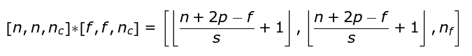
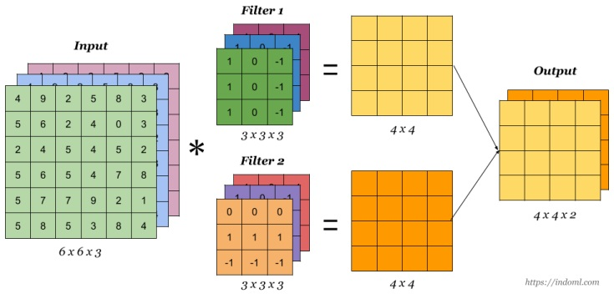
The transition to the third dimension
In which: n image size, f filter size, nc number of channels in the image, p used padding, s used stride, nf number of filters.
Notes:
Ref: https://indoml.com/2018/03/07/student-notes-convolutional-neural-networks-cnn-introduction/

Slide 24
Convolution Layer
We have learned to build a CNN operation
Methodology in layer work is almost identical to densely connected neural networks.
the only difference is that instead of using a simple matrix multiplication, this time we will use the convolution.
Forward propagation consists of two steps.
Calculate the intermediate value Z, which is obtained as a result of the convolution of the input data from the previous layer with W tensor (containing filters), and then adding bias b.
Apply a non-linear activation function to our intermediate value.

Slide 25
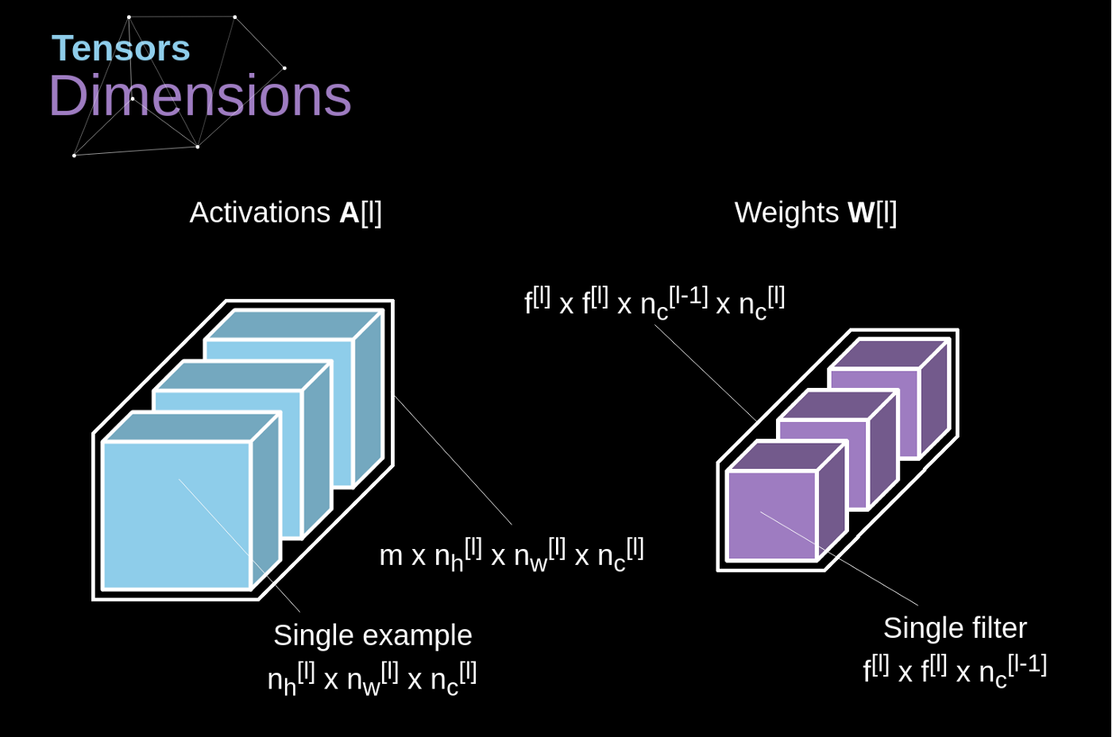
Convolution Layers
Where
l: layer
A: activation
H, w, c: height, width, channel
M: number of samples
F:filter
W: weights

Slide 26

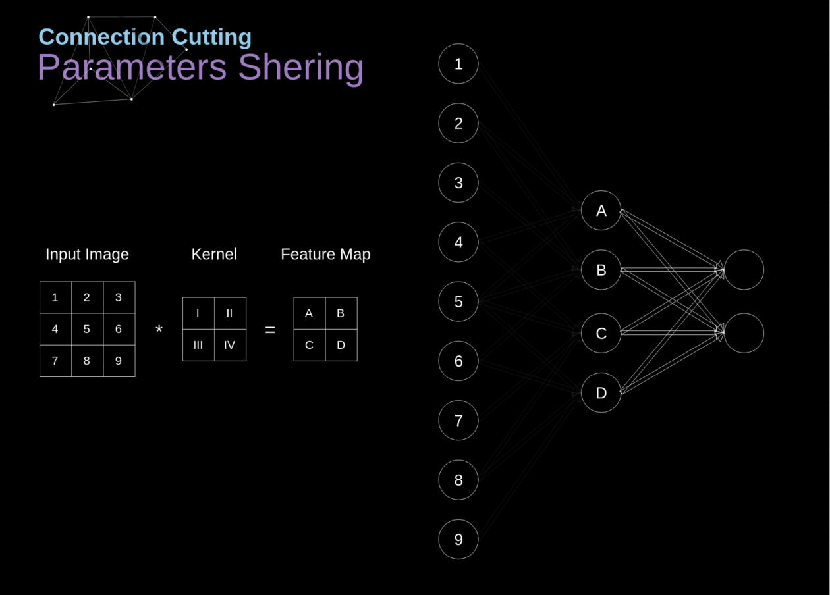
Connections Cutting and Parameters Sharing
From the convolution operation we notice one pixel value effect on different stride operation, this call parameter sharing

Slide 27
Connections Cutting and Parameters Sharing
We can see that not all neurons in the two consecutive layers are connected to each other.
For example,
unit 1 only affects the value of A.
Unit 5 in the middle on affect all values of A.B,C,D.
we see that some neurons share the same weights.
Both of these properties mean that we have less parameters to learn.
it is worth noting that a single value from the filter affects every element of the feature map it will be crucial in the context of backpropagation.

Slide 28
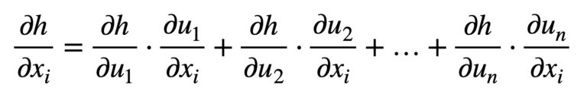
Convolutional Layer Backpropagation
Just like in densely connected neural networks, our goal is to calculate derivatives and later use them to update the values of our parameters in a process called gradient descent.
In our calculations we will use a chain rule. We want to assess the influence of the change in the parameters on the resulting features map, and subsequently on the final result.
Notes:
Chain rule = https://machinelearningmastery.com/the-chain-rule-of-calculus-for-univariate-and-multivariate-functions/
cnn Back propagation: https://pavisj.medium.com/convolutions-and-backpropagations-46026a8f5d2c

Slide 29
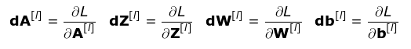
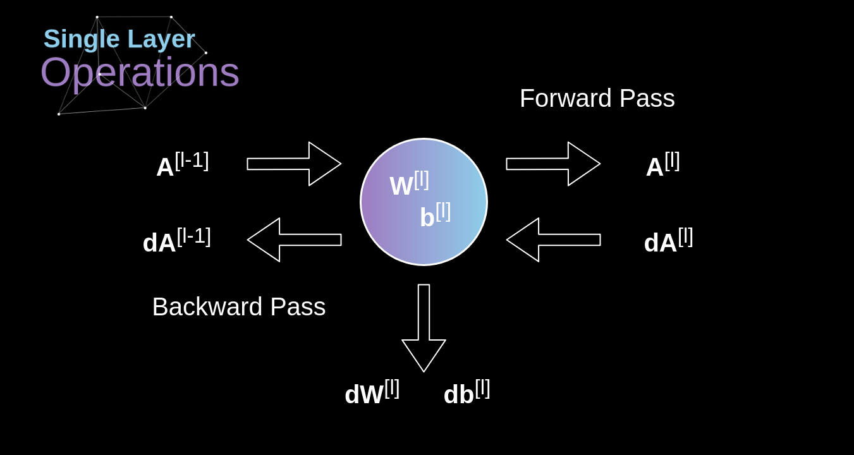
Convolutional Layer Backpropagation

Slide 30
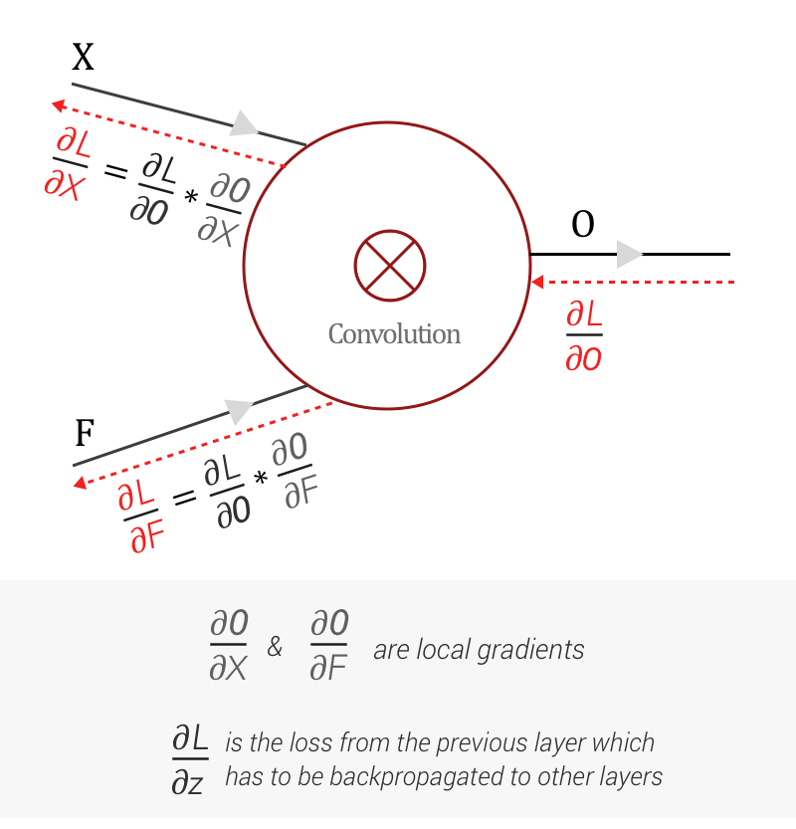
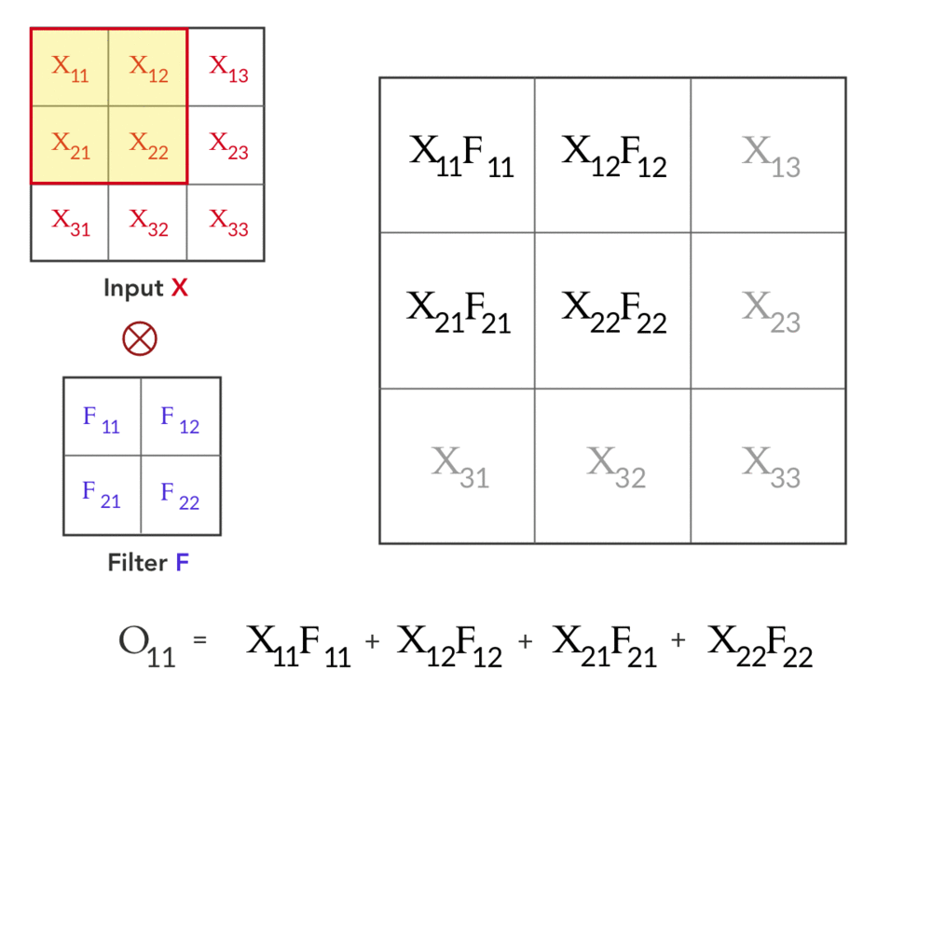
Forward & Backward CNN
Notes:
This gives us the forward pass! Let’s get to the Backward pass. As mentioned earlier, we get the loss gradient with respect to the Output O from the next layer as ∂L/∂O, during Backward pass. And combining with our previous knowledge using Chain rule and Backpropagation we get:

Slide 31
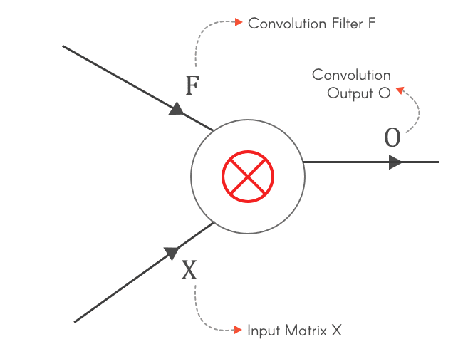
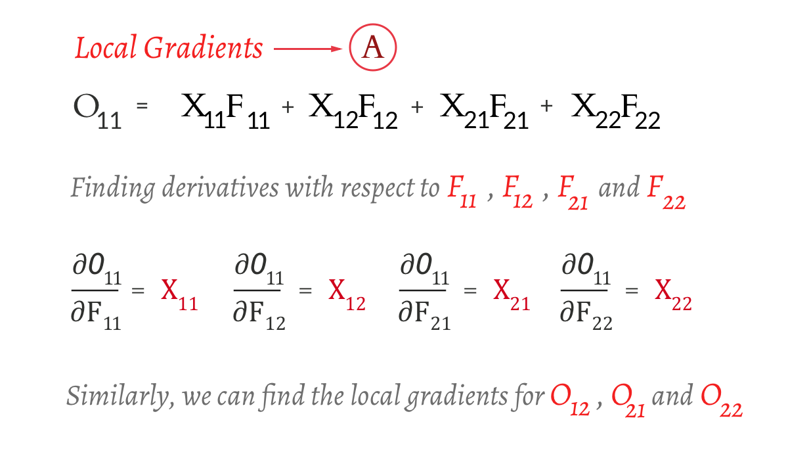
Finding the local gradient ∂O/∂F
Notes:
Finding ∂L/∂F
Find the local gradient ∂O/∂F
Find ∂L/∂F using chain rule

Slide 32
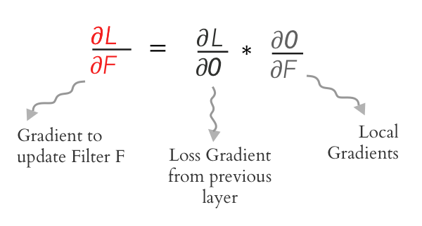
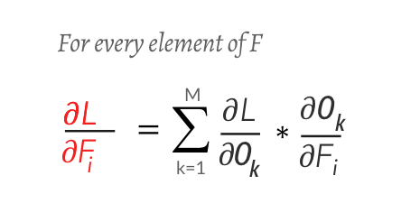
Using the Chain rule ∂O/∂F
Notes:
Expanding, we get..

Slide 33
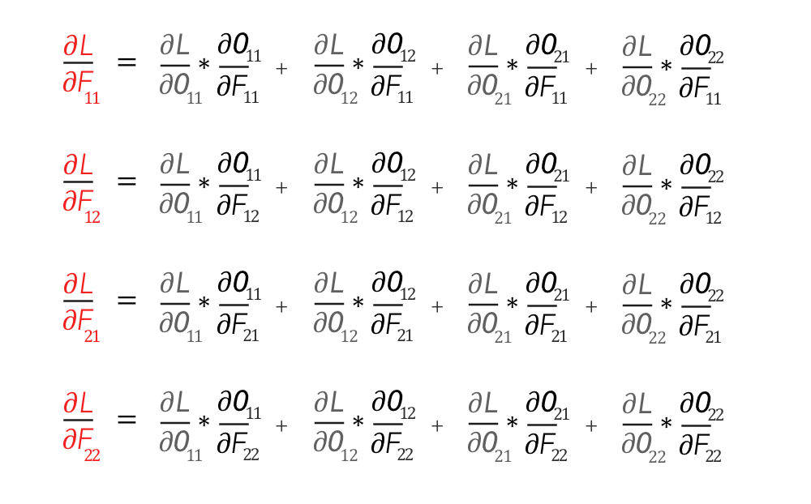
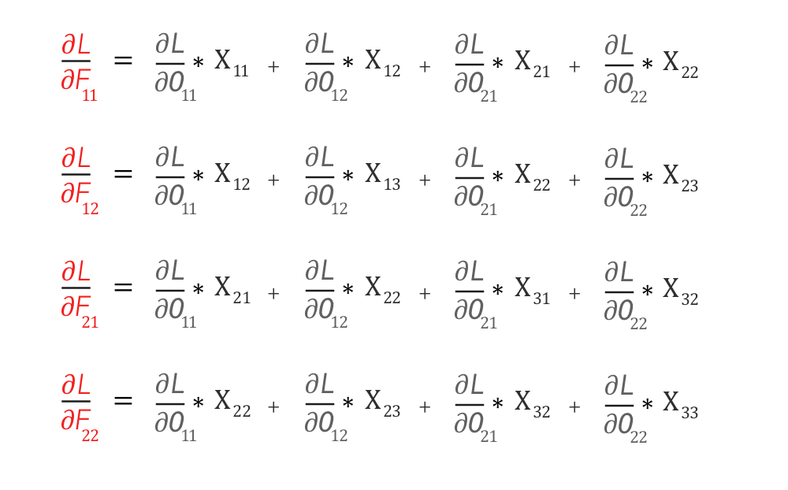
Using the Chain rule ∂O/∂F
Notes:
Substituting the values of the local gradient — ∂O/∂F from Equation A, we get

Slide 34
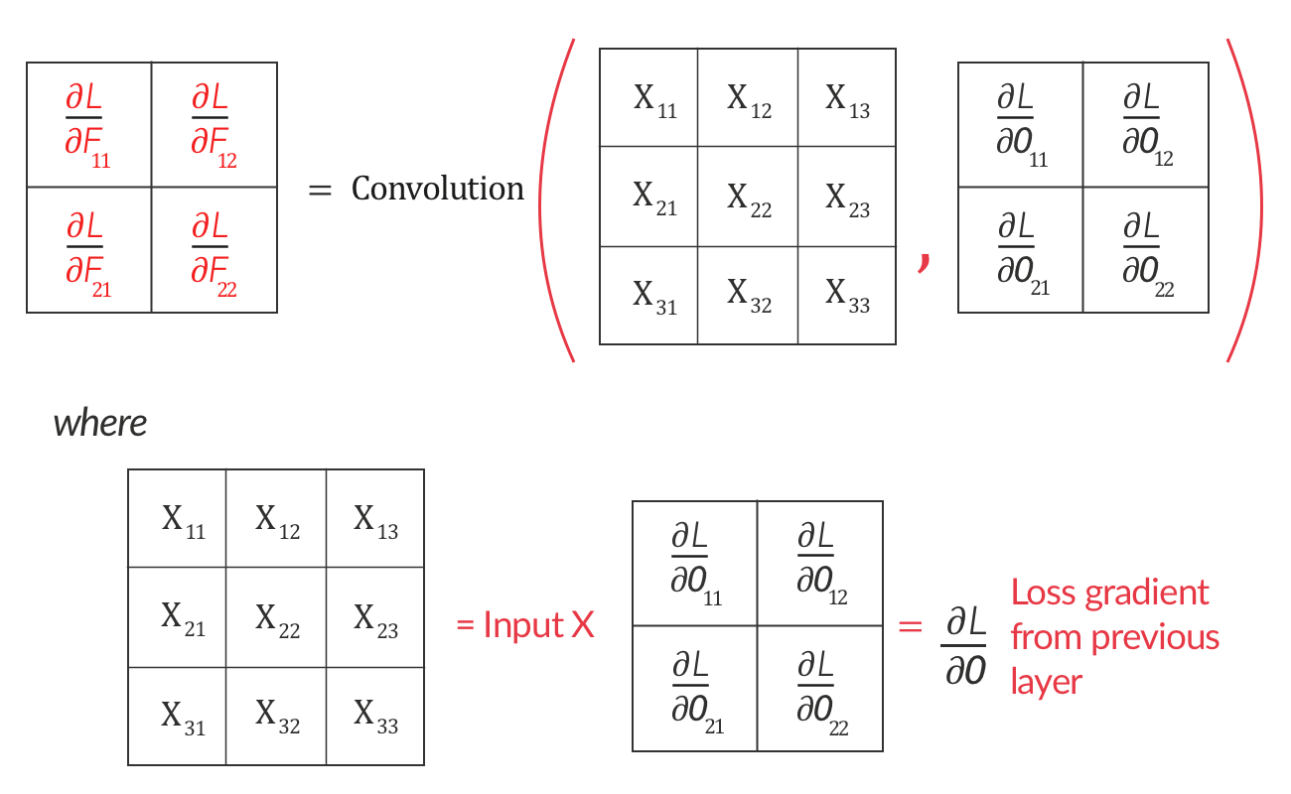
Using the Chain rule ∂O/∂F
Notes:
If you closely look at it, this represents an operation we are quite familiar with. We can represent it as a convolution operation between input X and loss gradient ∂L/∂O
∂L/∂F is nothing but the convolution between Input X and Loss Gradient from the next layer ∂L/∂O

Slide 35
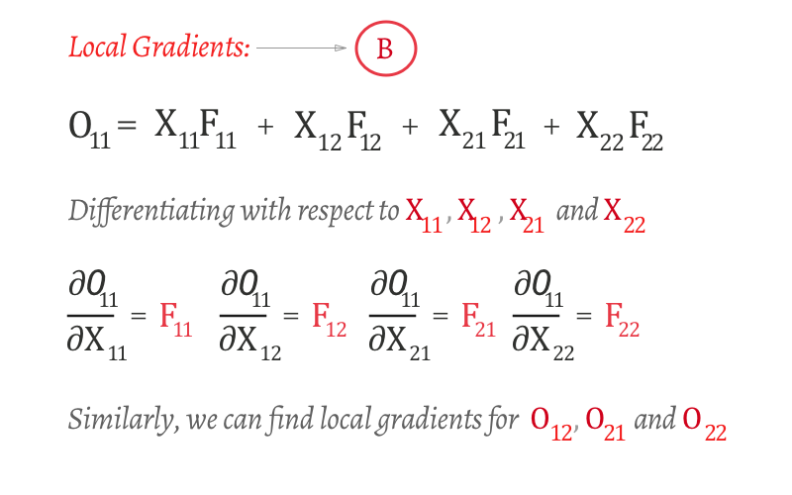
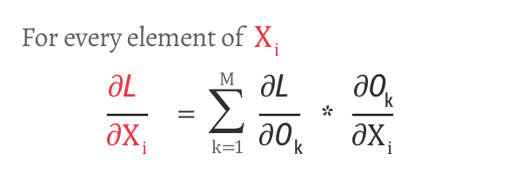
Finding the local gradient — ∂O/∂X
Notes:
Finding ∂L/∂X:

Slide 36
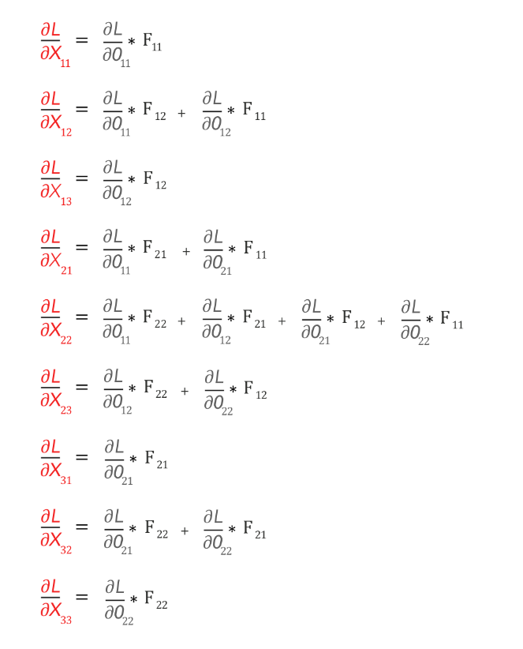
Using the Chain rule ∂O/∂X
Notes:
Now we have the values of ∂L/∂X.
Believe it or not, even this can be represented as a convolution operation.
∂L/∂X can be represented as ‘full’ convolution between a 180-degree rotated Filter F and loss gradient ∂L/∂O

Slide 37
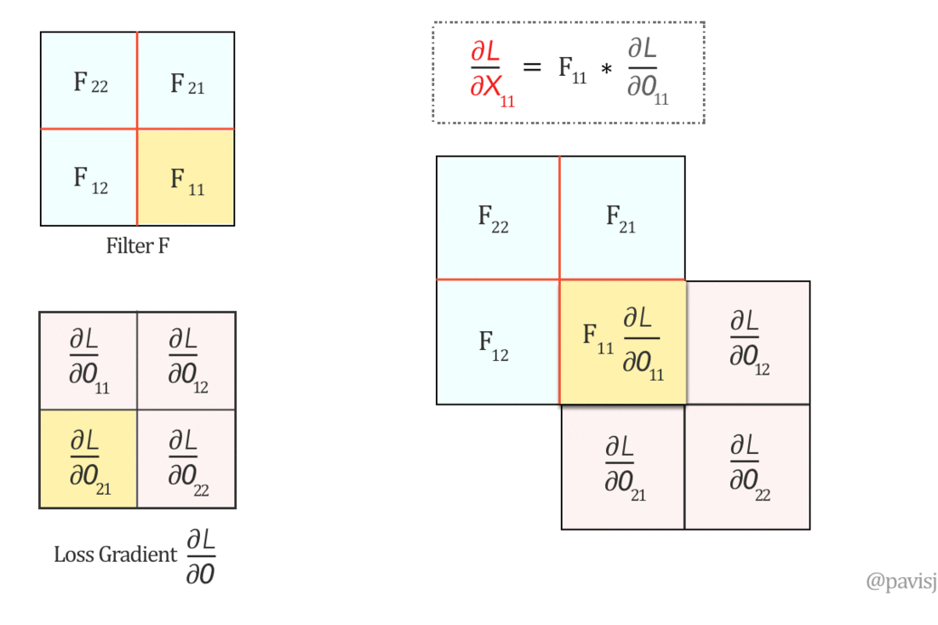
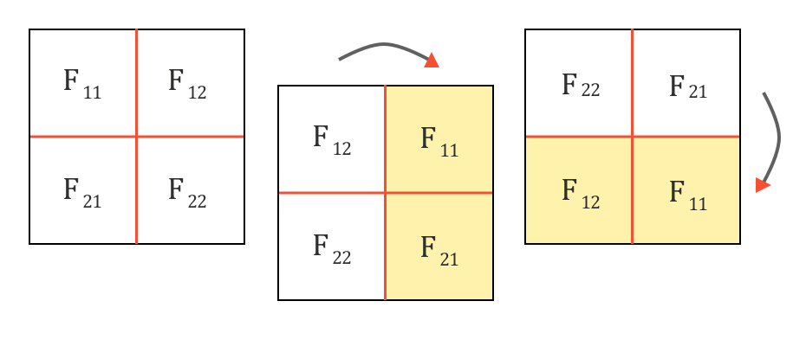
∂L/∂X Representation
Notes:
let us rotate the Filter F by 180 degrees. This is done by flipping it first vertically and then horizontally.
let us do a ‘full’ convolution between this flipped Filter F and ∂L/∂O, which can be visualized as below: (It is like sliding one matrix over another from right to left, bottom to top)

Slide 38
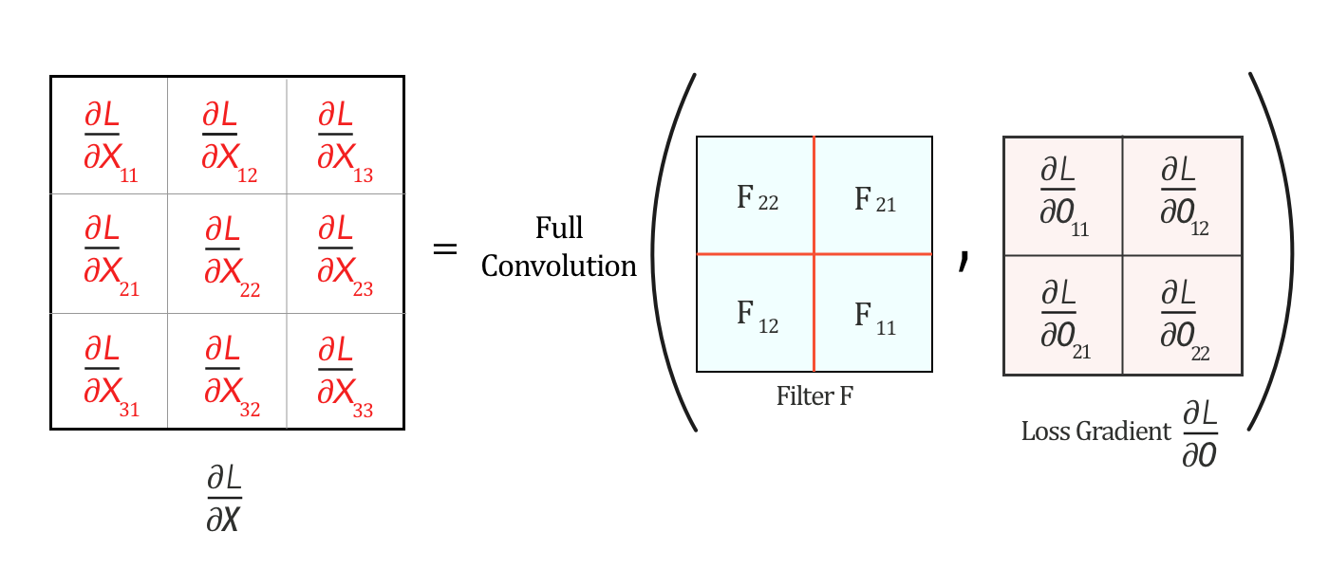
∂L/∂X Representation
Notes:
The full convolution above generates the values of ∂L/∂X and hence we can represent ∂L/∂X as

Slide 39
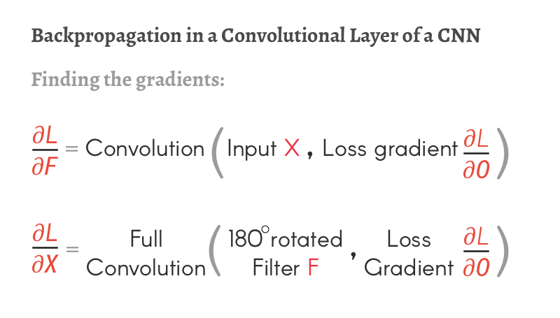
CNN Backpropagation
Now we have found ∂L/∂X and ∂L/∂F, we can now come to this conclusion
Both the Forward pass and the Backpropagation of a Convolutional layer are Convolutions
Summing it up:

Slide 40
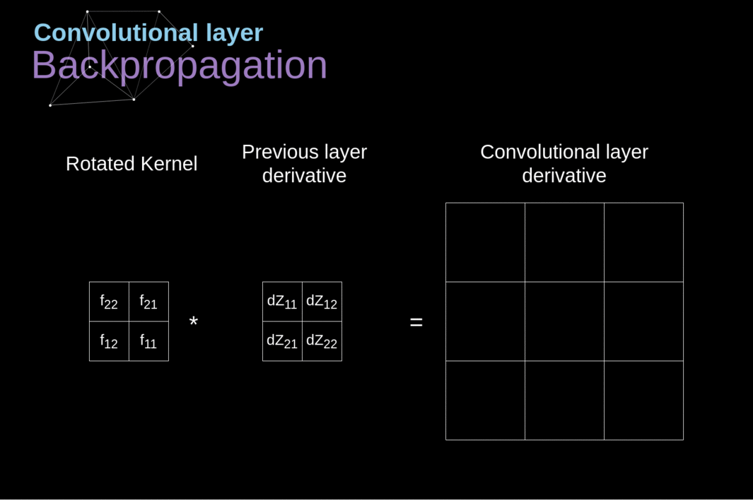
CNN Backpropagation

Slide 41
Pooling Layer
They are used primarily to reduce the size of the tensor and speed up calculations.
we need to divide our image into different regions, and then perform some operation for each of those parts.
For example,
the Max Pool Layer, we select a maximum value from each region and put it in the corresponding place in the output.
As in the case of the convolution layer, we have two hyperparameters available filter size and stride.
if you are performing pooling for a multi-channel image, the pooling for each channel should be done separately.
Notes:
Max pooling: The maximum pixel value of the batch is selected.
Min pooling: The minimum pixel value of the batch is selected.
Average pooling: The average value of all the pixels in the batch is selected.
Pooling: https://medium.com/@bdhuma/which-pooling-method-is-better-maxpooling-vs-minpooling-vs-average-pooling-95fb03f45a9

Slide 42
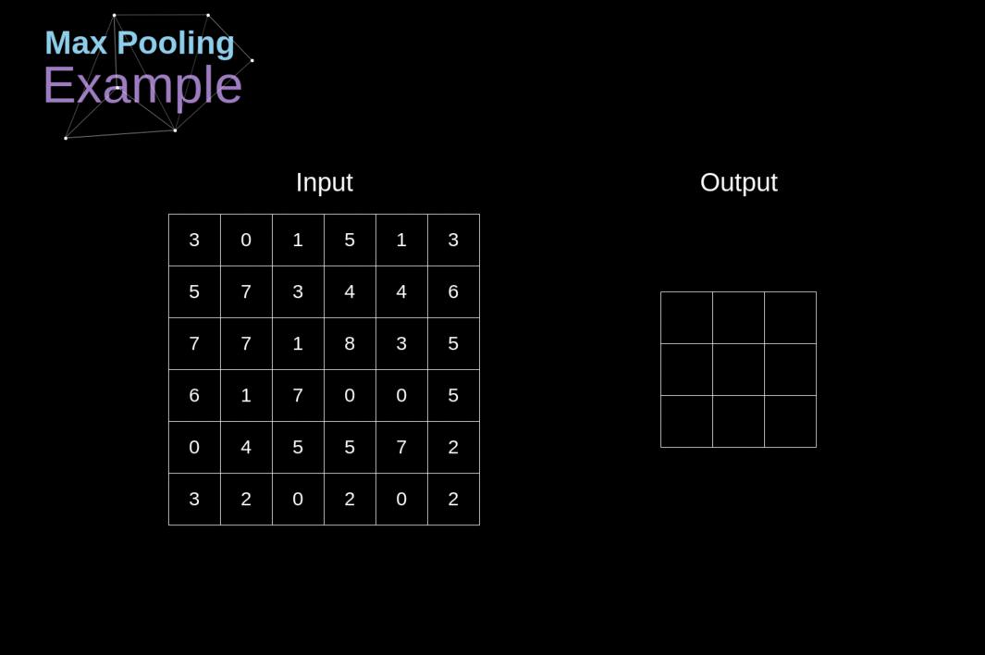
Pooling Layer

Slide 43
Pooling Backpropagation
Since in layers of this type, we don’t have any parameters that we would have to update.
Our task is only to distribute gradients appropriately.
As we remember, in the forward propagation for max pooling, we select the maximum value from each region and transfer them to the next layer. It is therefore clear that during back propagation,
the gradient should not affect elements of the matrix that were not included in the forward pass.
In practice, this is achieved by creating a mask that remembers the position of the values used in the first phase, which we can later utilize to transfer the gradients.

Slide 44
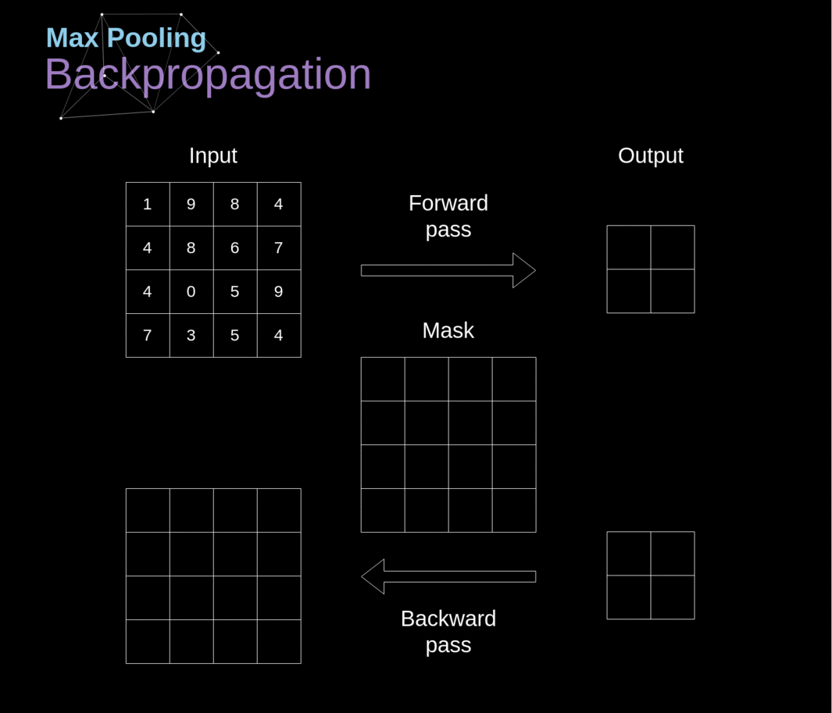
Pooling Backpropagation

Slide 45
Training CNN
So how the CNN Capture image patterns ?
The first (or bottom) layer of the CNN usually detects basic features such as horizontal, vertical, and diagonal edges.
The output of the first layer is fed as input of the next layer, which extracts more complex features, such as corners and combinations of edges.
As you move deeper into the convolutional neural network, the layers start detecting higher-level features such as objects, faces, and more.
Notes:
Ref:

Slide 46
Training CNN
A CNN is usually composed of several convolution layers, but it also contains other components(Time Distribution, LSTM, Pooling, Dense, Dropout …).
The final layer of a CNN is a classification layer, which takes the output of the final convolution layer as input (remember, the higher convolution layers detect complex objects).
Based on the activation map of the final convolution layer, the classification layer outputs a set of confidence scores (values between 0 and 1) that specify how likely the image is to belong to a “class.” For instance,
if you have a ConvNet that detects cats, dogs, and horses, the output of the final layer is the possibility that the input image contains any of those animals.

Slide 47
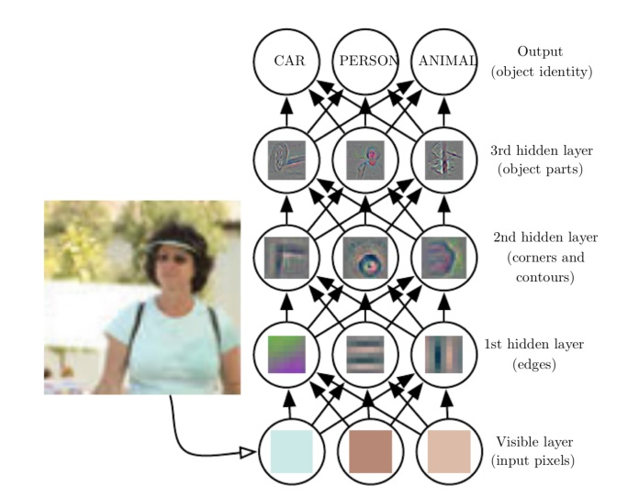
Training CNN

Slide 48
Training CNN
If a CNN scores good on its training data but scores bad on the test data, it is said to have been “overfitted.” This usually happens when there’s not enough variety in the training or the model try too many epochs on the training dataset.
The success of convolutional neural networks is largely due to the availability of huge image datasets developed in the past decade.
We don’t, however, need to train every convolutional neural network on millions of images. In many cases, you can use a pretrained model, such as the AlexNet or Microsoft’s ResNet, and finetune it for another more specialized application. This process is called transfer learning, in which a trained neural network is retrained a smaller set of new examples.

Slide 49
CNN in Real World App
Face detection: CNNs have been used to detect faces within images. The network takes an image as the input and produces a set of values that represent characteristics of faces or facial features at different parts of the image. CNN has shown improved accuracy over previous algorithms, identifying faces 97% of the time according to various research papers. CNN can also be used to help reduce the amount of distortion in a face. CNNs can detect features such as eyes, nose, and mouth with great accuracy reducing distortions from things like angles or shadows on faces.
Facial emotion recognition: CNNs have been used to help distinguish between different facial expressions such as anger, sadness, or happiness. CNNs can also be adapted to perform well with various lighting conditions and angles of faces within images.
Notes:
Ref: https://theappsolutions.com/blog/development/convolutional-neural-networks/

Slide 50
CNN Real World App
Object detection: CNN has been applied to object recognition across images by classifying objects based on shapes and patterns found within an image. CNN models have been created that can detect a wide range of objects from everyday items such as food, celebrities, or animals to more unusual ones including dollar bills and guns. Object detection is performed using techniques such as semantic or instance segmentation. CNNs have been used to localize and identify objects within images as well as create different views of those objects such as for use in drones or self-driving cars.
Self-driving or autonomous cars: CNN has been used within the context of automated vehicles to enable them to detect obstacles or interpret street signs. CNNs have been used in conjunction with reinforcement learning, a branch of machine learning that focuses on positive and negative feedback from the environment to improve how CNN models respond when encountering certain situations.

Slide 51
CNN Real World App
Auto translation: CNN is being used within the context of deep learning for automated translation between language pairs such as English and French. CNNs have been used to translate between language pairs such as Chinese and English with a high degree of accuracy, removing the need for word-for-word translation or bilingual human assistants.
Next word prediction in sentence: CNNs have been used to predict the next word of a sentence given some context. CNN models can process multiple sentences and learn which words typically follow others, such as “I am from Egypt” followed by “I speak Arabic.”

Slide 52
CNN Real World App
Handwritten character recognition: CNNs can be used to recognize handwritten characters. CNNs take the image of a character as an input and break it down into smaller sections, identifying points that can connect or overlap with other points in order to determine the shape of the larger character. CNN models have been created that are able to identify different languages including Chinese, Arabic, and Russian even when they’re written differently.
X-ray image analysis: CNNs have been used for medical imaging to identify tumors or other abnormalities in X-ray images. CNN models can take an image of a human body part, such as the knee, and determine where within that image there might be a tumor based on previous similar images processed by CNN networks. CNN models can also be used to determine abnormalities from X-ray images. CNNs have been used to determine which area of an X-ray image contains a tumor or other abnormalities such as fractured bones.

Slide 53
CNN Real World App
Cancer detection: CNNs have been used to detect cancer in medical images such as mammograms and CT scans. CNN models take the image of a patient and compare it against database images that contain similar characteristics, identifying when there are signs present within an image that indicate malignancy or damage to cells due both to genetics and environmental factors such as smoking habits. CNN models are able to produce highly accurate results and CNNs have even been able to identify cancerous cells with an accuracy of 95% compared to the 85-90% rate that pathologists were capable of identifying.
Visual question answering: CNN has also been applied to visual question answering which is the task of asking a natural language question about an image and then providing an accurate answer based on that image. CNNs can take an image as input and return a natural language answer to any question asked about that image.

Slide 54
CNN Real World App
Image captioning: CNN is also being used for the task of generating short captions describing what’s contained within new images fed into CNN networks or processing multiple images at once with existing ones, such as those found on social media sites. CNN models can take a sequence of images as input and generate one or more sentences that describe what’s contained within those images.
Document classification: CNNs have been used to classify documents into different categories. CNN models can identify which category a document belongs to based on the content of that document, such as articles about sports or politics. CNN networks are able to use both text and images in order to better understand what’s contained within a specific document by identifying keywords and phrases related to the topic of that document. CNN models have also been used to summarize documents based on their content, identifying key points within a document and explaining what’s contained in those key points.

Slide 55
CNN Real World App
Biometric authentication: CNN has been used for biometric authentication of user identity by identifying certain physical characteristics associated with a person’s face. CNN models can train on images or videos of people and generate an output vector that identifies specific facial features, such as the distance between eyes, nose shape, lip curvature, etc. CNN models have also identified different emotional expressions based on facial images or videos of people, such as happy or sad. CNNs can also detect if a person is blinking in an image and determine the overall shape of facial images containing multiple frames, identifying key points on each frame that are useful for training CNN models to understand what’s contained within those images.
3D medical image segmentation: CNN has been used for the task of segmenting medical imaging scans, such as MRI images. CNN models can take an image slice from a three-dimensional scan and determine where within that image there are different tissue types based on previous similar images processed by CNN networks

Slide 56
Tesla Hydranet
How Do We Make A Car Autonomous?
The 8 cameras(Left) around vehicle generate 3-Dimensional “Vector Space” (Right)through Neural Networks, which represents everything you need for driving, such as lines, edges, curbs, traffic signs, traffic lights, cars; and positions, orientations, depth, velocities of cars.
What Tesla has to do is to build a vision-based computer neural network system like the human brain. Through software, hardware and algorithms design the visual cortex of the car?
The input of Tesla Vision comes from raw format (digital negatives) video data provided by its eyes — 8 cameras(1280x960 12-Bit(HDR)@ 36Hz). You may have discovered that there are no other sensors such as Lidars or mmWave radars except for the cameras. Later Andrej will explain and prove why Tesla decided to use only 8 cameras.
Notes:
Ref: https://saneryee-studio.medium.com/deep-understanding-tesla-fsd-part-1-hydranet-1b46106d57

Slide 57
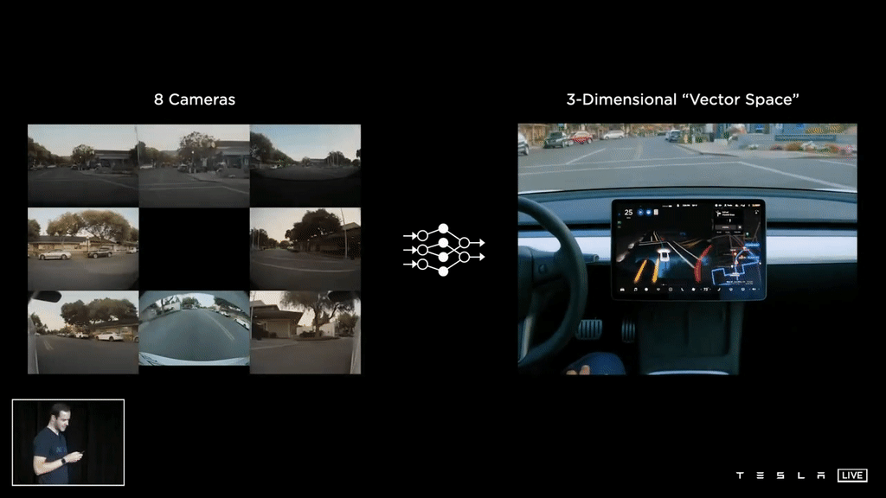
Tesla Hydranet

Slide 58
Tesla Hydranet
Backbone: refers to the feature extracting network, which is used to recognize several objects in a single image and provides rich features information of objects. We often use AlexNet, ResNet, VGGNet as backbone networks.
Detection Head(head): After the feature extract (backbone), it gives us a feature maps representation of the input. For some actual tasks, such as detection object, segmentation, etc. We usually apply a “detection head” on the feature maps, so it’s like a head attached to the backbone.
neck: The neck is between the backbone and head, it is used to extract some more elaborate features.(e.g. feautre pyramid network(FPN), BiFPN)
There is a general structure for object detection:
Input → backbone → neck → head → Output

Slide 59
Tesla Hydranet
Initially, in the object detection task, we used some manually designed networks, such as AlexNet, VGG, ResNet, DenseNet…, as the backbone. Later, as the scale of data and network depth increased, researchers began to consider using semi-automated network design and automated network design instead of manual network design. Well-known paradigms at this stage are AutoML and NAS (Neural architecture search).
Despite the effectiveness of AutoML and NAS, they have limitations:
1) high resource consumption,
2) poor flexibility,
3) poor generalization,
4) design results are hard to understand.
Tesla uses the Regnet(regular network structures) designed with residual neural network blocks as its neural network backbone.
Notes:
AlexNet: https://en.wikipedia.org/wiki/AlexNet
VGG: https://towardsdatascience.com/vgg-neural-networks-the-next-step-after-alexnet-3f91fa9ffe2c
ResNet: https://en.wikipedia.org/wiki/Residual_neural_network
DenseNet: https://towardsdatascience.com/review-densenet-image-classification-b6631a8ef803
AutoMl, NAS: https://arxiv.org/abs/1810.13306

Slide 60
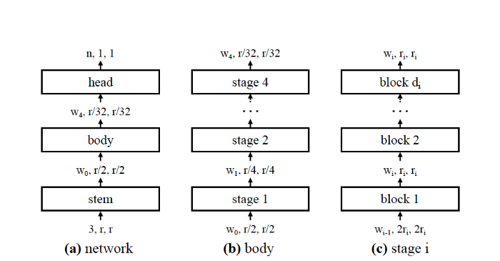
RegNet
Notes:
RegNet: https://towardsdatascience.com/regnet-the-most-flexible-network-architecture-for-computer-vision-2fd757f9c5cd

Slide 61
RegNet
Stem: Use a convolution (kernel_size =3, stride =2, w0 = 32 output channels) to process the images and resolution reduced by one-half.
Body: Performs the bulk of the computation. The network body is composed of a sequence of stages that operate at progressively reduced resolution. Each stage consists of a sequence of identical blocks.
Head: Predicts n outputs classes.
Stage: All convolutional layers producing output maps of the same size are in the same network stage. The feature maps of different stages are used to form the feature pyramid network.

Slide 62
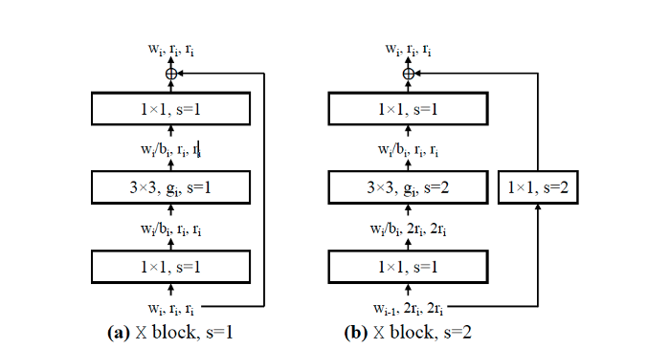
RegNet

Slide 63
RegNet
The image above (bottom right) shows the two types of X block. The X block is based on the standard residual bottleneck with group convolution
Each X block consists of a 1x1 conv, a 3x3 group conv, and a final 1x1 conv, where the 1x1 conv alter the channel width. (b) version stride two(s=2).
After the neural network backbone processing, the RegNet gives a number of features at different resolutions in different scales. In this feature extracting network, on the very bottom we have very high resolution with very low channel counts, and low resolution with high channel counts at the top.
the neurons on the bottom are used to scrutinize the details of the image,
the top neurons are used to understand the scene context (semantic) information. These features of different scales and resolutions will enter the next processing feature pyramid network.

Slide 64
Feature pyramid networks (Neck)
Early object detection algorithms usually directly connect the detection head on the feature map of the last layer of the last stage of the backbone. In the object detection task,
the shallow networks (bottom of the networks) have a high resolution, which is helpful for the learning of image details.
the deep networks (top of the networks), a resolution is low, which is good for semantic learning.
In practice, we find that it is difficult to effectively identify objects of different scales on a single feature map at the same time.

Slide 65
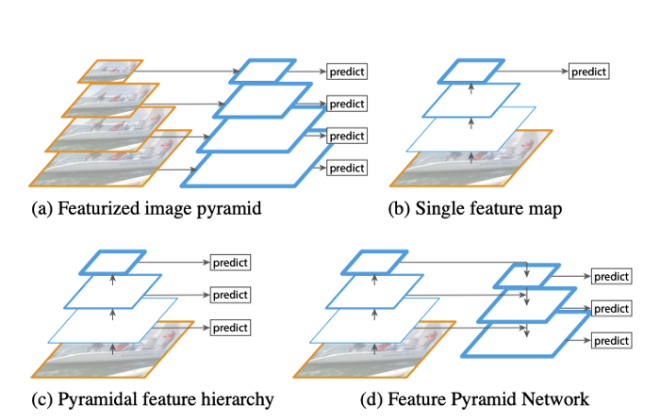
Feature pyramid networks

Slide 66
Feature pyramid networks
The evolution of FPN:
is a traditional featured image pyramid which is using an image pyramid to build a feature pyramid. Features are computed on each of the image scales independently. It is very slow.
is using deep convolutional networks(ConvNets) in a single feature map. This method represents more higher-level semantics.
is the Single Shot Detector(SSD) algorithm, which would reuse the multi-scale feature maps from different layers to predict. But it has weak semantics at a low level.
is an architecture that combines low-resolution, semantically strong features with high-resolution, semantically weak features via a top-down pathway and lateral connections. This architecture learns from the detection strategy of SSD and the “shortcut connections” in ResNet.

Slide 67
Yolo (Head)
After the Neck layer, the detection head part of the network is connected, This detection head is composed of a number of task-specific heads.
when you want to detect a car, use one-stage YOLO-like object detector as the head.
Notes:
Yolo: https://arxiv.org/abs/1506.02640
YOLO algorithm employs convolutional neural networks (CNN) to detect objects in real-time. As the name suggests, the algorithm requires only a single forward propagation through a neural network to detect objects.
This means that prediction in the entire image is done in a single algorithm run. The CNN is used to predict various class probabilities and bounding boxes simultaneously.
The YOLO algorithm consists of various variants.

Slide 68
ANY QUESTIONS ?

